Slide 1
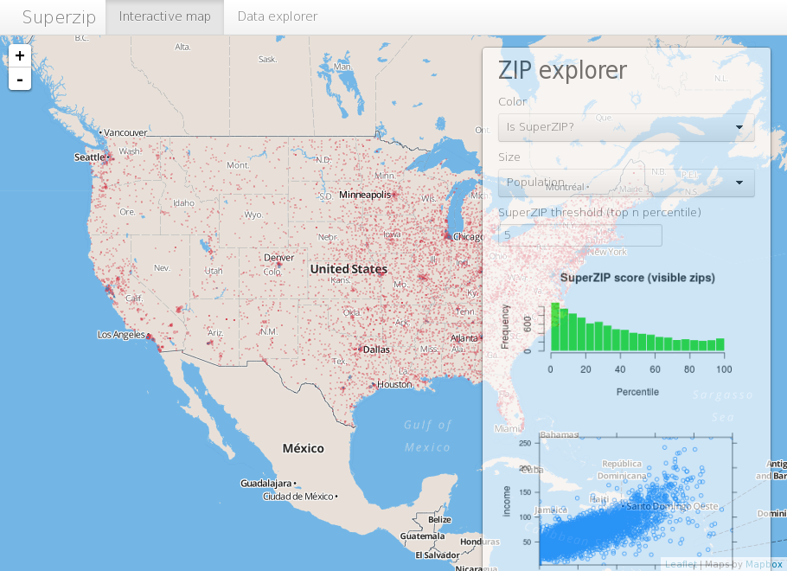
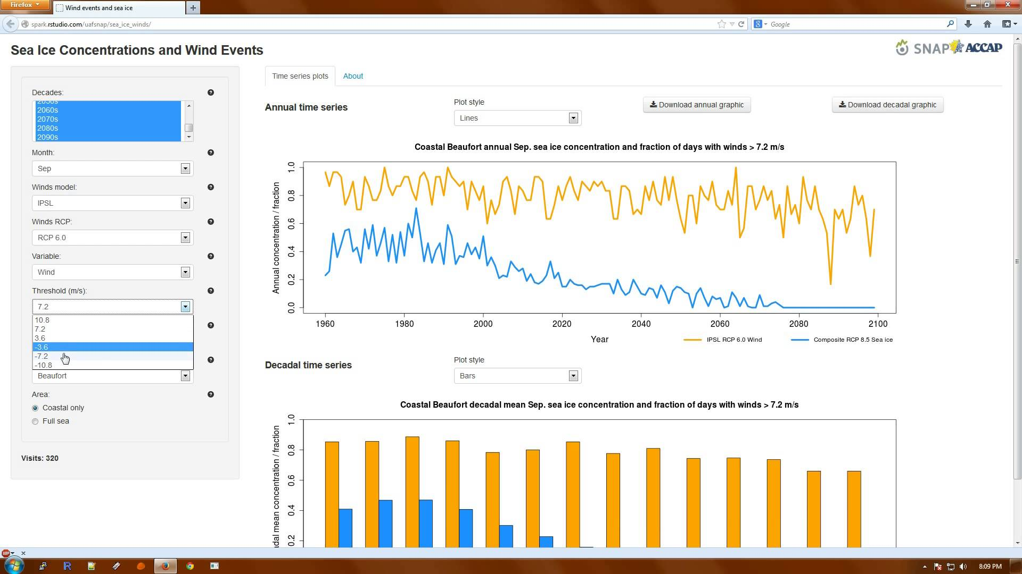
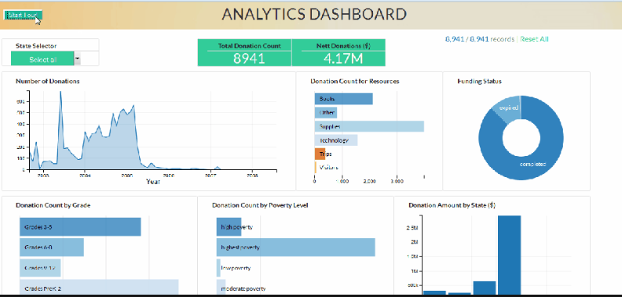
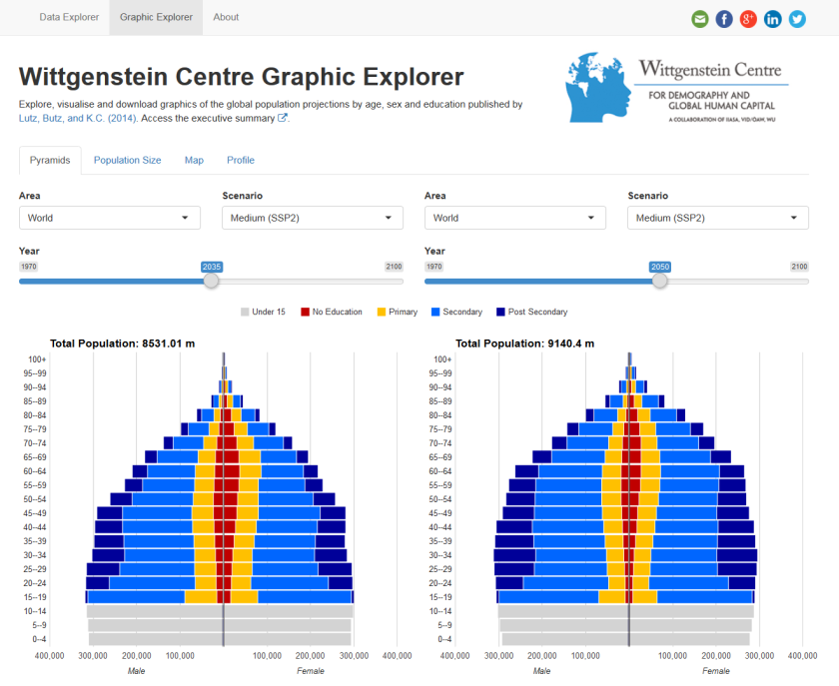
Shiny Apps Build Interactive Web Applications With R
Prepared by
Aep Hidayatuloh
aephidayatuloh.mail@gmail.com

Slide 2
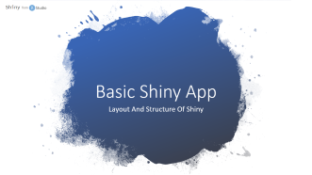

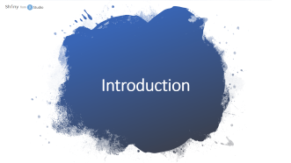


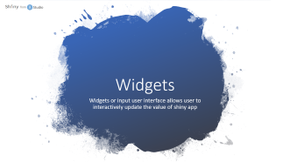
Outline

Slide 3


Introduction

Slide 4
Welcome to Shiny
Shiny is an R package that makes it easy to build interactive web applications (apps) straight from R.
i.e. Entry data form, analytic dashboard etc.
The default styling of a Shiny application is clean and effective.
Very extensible and it is easy to integrate Shiny applications with your own web content using HTML and CSS.
JavaScript and jQuery can also be used to further extend the scope of Shiny applications.

Slide 5
Requirement
Tools
Latest version of R or Microsoft R Open (64-bit only)
Latest version of RStudio and shiny package
Browser (Mozilla Firefox, Google Chrome etc.)
Knowledge
R programming
Basic web knowledges

Slide 6
What will be discussed?
Basic Shiny Apps
Basic components of Shiny Apps
Build Simple Interactive Shiny Apps
Publish Apps
Create and setting account
Publish and access the apps

Slide 7
Basic Shiny App
Layout And Structure Of Shiny

Slide 8
Lets Get Started!
Install R/Microsoft R Open and RStudio
R : https://cran.r-project.org/
MRO : https://mran.microsoft.com/open
RStudio : https://www.rstudio.com/products/rstudio/download/
Install shiny package
# Install shiny package
install.package("shiny")

Slide 9
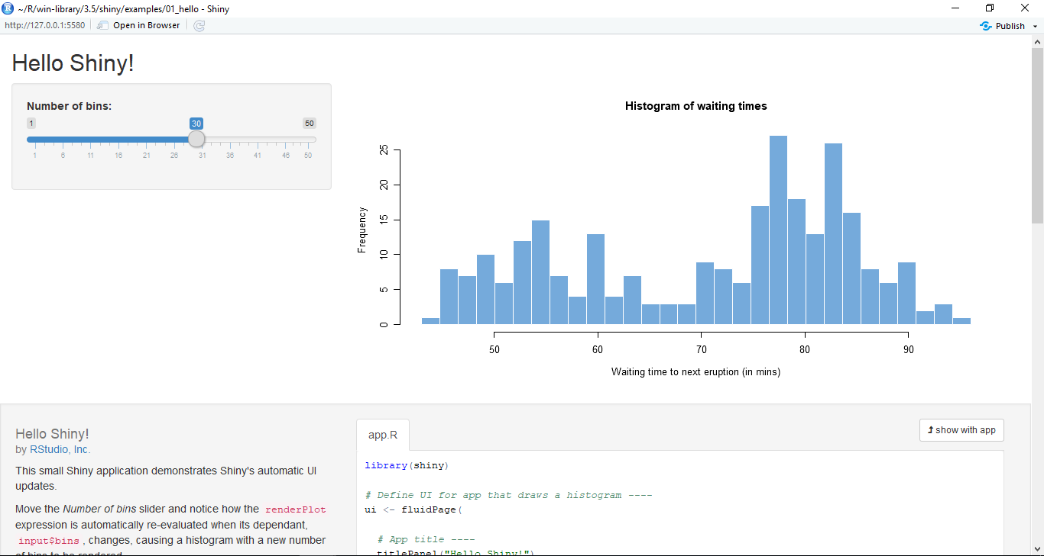
Hello Shiny!
# Example of shiny app
library(shiny)
runExample("01_hello")

Slide 10
Basic Shiny Apps
Layout
Title/Header Panel
Sidebar/Input Panel
Main/Output Panel

Slide 11
Basic Shiny App Code – Single File
ui & server in a file named app.R
# file app.R
library(shiny)
ui <- fluidPage()
server <- function(input, output <, session>){}
shinyApp(ui, server)
<, session> means session argument is optional

Slide 12
Basic Shiny App Code – Multiple File
ui & server in separated file named ui.R and server.R but in the same folder
# file ui.R
library(shiny)
shinyUI(fluidPage(
)
)
# file server.R
library(shiny)
shinyServer(function(input, output <, session>){
}
)

Slide 13
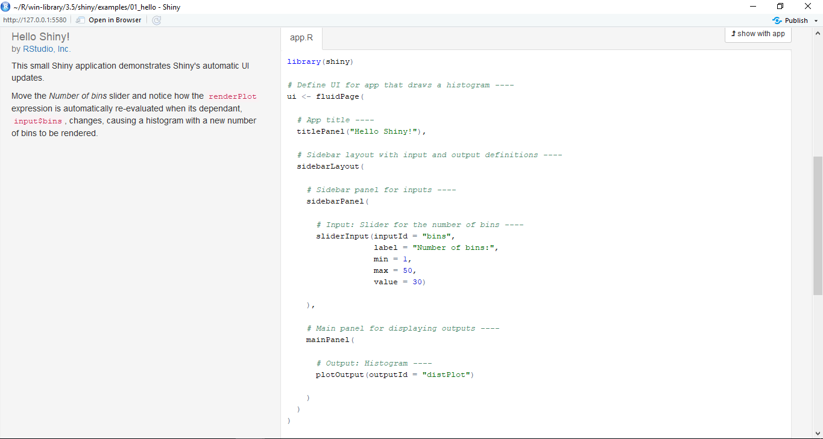
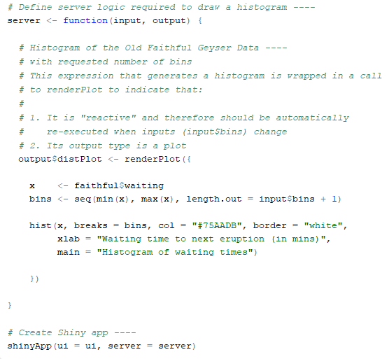
Inspect The App!
Single or Multiple file?

Slide 14
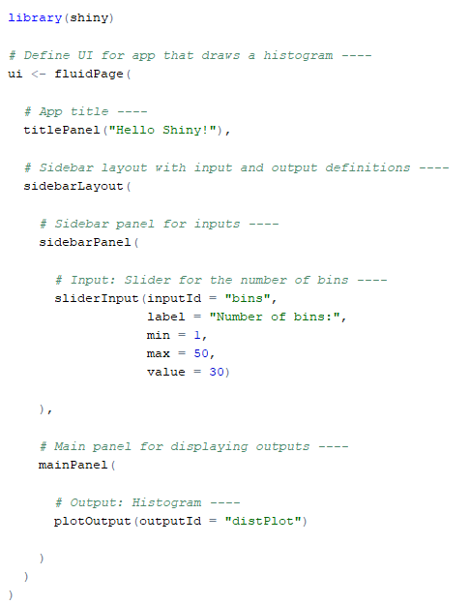
Inspect The App!
Load the shiny package
Define the UI
App’s title
Page with Sidebar Panel
Sidebar/Input Panel
Slider as interactive input
Main/Output Panel
Output from server

Slide 15
Inspect The App!
Define the Server
Comment in the
script using #
Create output with
output$<outputId>
Render the ouput (i.e histogram plot)
Create histogram
Run the app

Slide 16
Widgets
Widgets or input user interface allows user to interactively update the value of shiny app

Slide 17
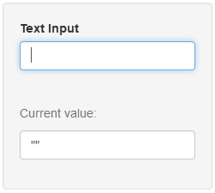
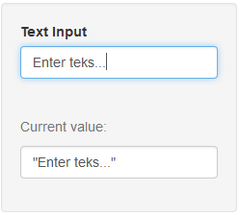
Widgets – Text Input
textInput(inputId, label, value = "", width = NULL, placeholder = NULL)

Slide 18
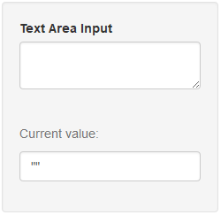
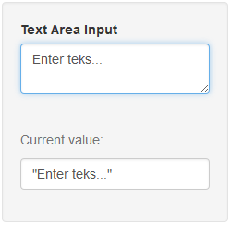
Widgets – Text Area Input
textAreaInput(inputId, label, value = "", width = NULL, height = NULL,
cols = NULL, rows = NULL, placeholder = NULL, resize = NULL)

Slide 19
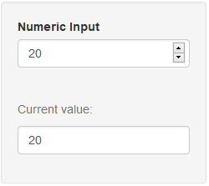
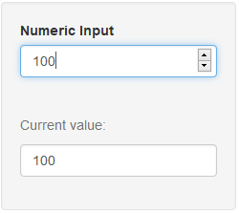
Widgets – Numeric Input
numericInput(inputId, label, value, min = NA, max = NA, step = NA,
width = NULL)

Slide 20
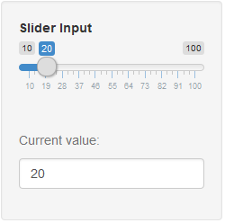
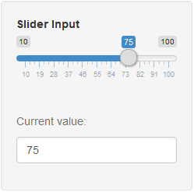
Widgets – Slider Input
sliderInput(inputId, label, min, max, value, step = NULL, round = FALSE,
format = NULL, locale = NULL, ticks = TRUE, animate = FALSE,
width = NULL, sep = ",", pre = NULL, post = NULL, timeFormat = NULL,
timezone = NULL, dragRange = TRUE)

Slide 21
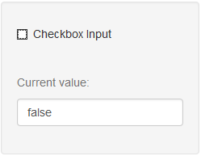
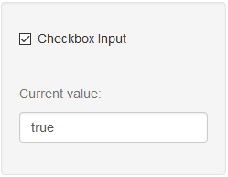
Widgets – Checkbox Input
checkboxInput(inputId, label, value = FALSE, width = NULL)

Slide 22
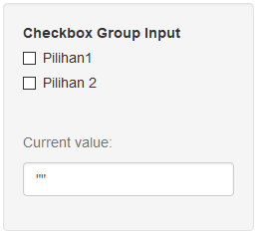
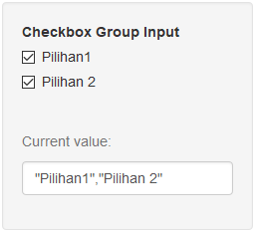
Widgets – Checkbox Group Input
checkboxGroupInput(inputId, label, choices = NULL, selected = NULL,
inline = FALSE, width = NULL, choiceNames = NULL, choiceValues = NULL)

Slide 23
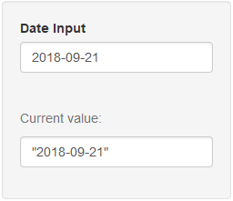
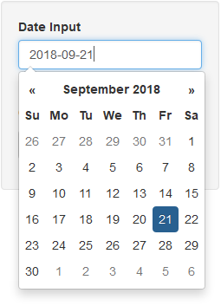
Widgets – Date Input
dateInput(inputId, label, value = NULL, min = NULL, max = NULL,
format = "yyyy-mm-dd", startview = "month", weekstart = 0,
language = "en", width = NULL, autoclose = TRUE)

Slide 24
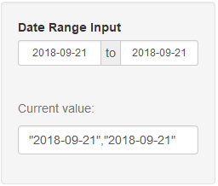
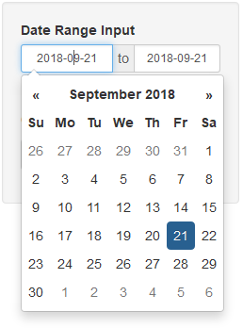
Widgets – Date Range Input
dateRangeInput(inputId, label, start = NULL, end = NULL, min = NULL,
max = NULL, format = "yyyy-mm-dd", startview = "month", weekstart = 0,
language = "en", separator = " to ", width = NULL, autoclose = TRUE)

Slide 25
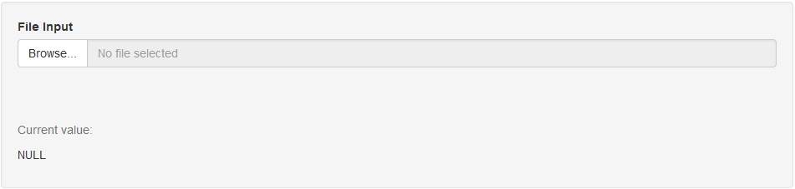
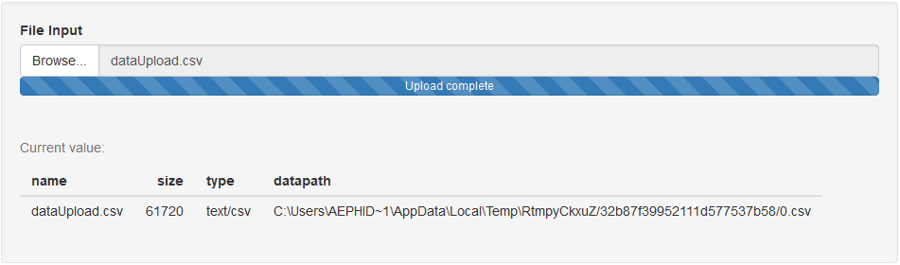
Widgets – File Input
fileInput(inputId, label, multiple = FALSE, accept = NULL, width = NULL,
buttonLabel = "Browse...", placeholder = "No file selected")

Slide 26
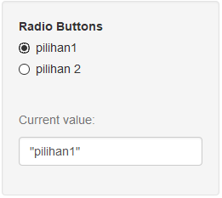
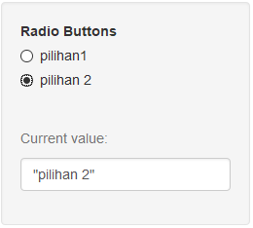
Widgets – Radio Buttons
radioButtons(inputId, label, choices = NULL, selected = NULL,
inline = FALSE, width = NULL, choiceNames = NULL, choiceValues = NULL)

Slide 27
Multiple File Shiny
Shiny App with Two File, ui.R and server.R

Slide 28
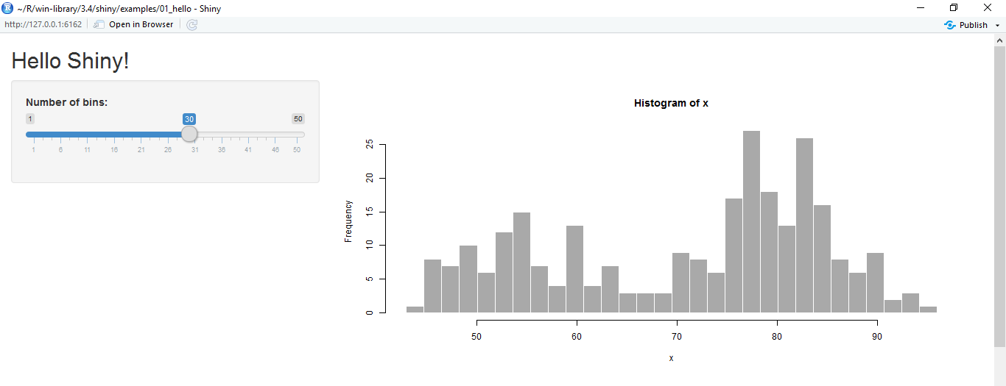
Basic Shiny Apps
Layout
Title/Header Panel
Sidebar/Input Panel
Main/Output Panel
You can create shiny apps with single file app.R or two files ui.R and server.R
ui.R
server.R
User Interface
Computation Processes

Slide 29
Shiny ui.R and server.R
ui.R
server.R
User Interface
Computation Processes
User Interface
Control the layout, appearance, widget for user inputs and display the output.
E.g. the title, page layout, text input, radio button, dropdown menu, graphics output etc.
Server
Set of instructions that uses the input provided by user, process them and produces the required output which is further displayed by ui.R

Slide 30
Shiny App – Multiple File
ui & server in separated file named ui.R and server.R but in the same folder
# file ui.R
library(shiny)
shinyUI(fluidPage(
........
)
)
# file server.R
library(shiny)
shinyServer(function(input, output <, session>){
........
}
)

Slide 31
Create the Brain
All processes are done in server.R.
All generated objects (vector, table, plot, text, UI etc.) based on input should be created in reactive function (reactive(), render*(), observe() etc.).
render*() → *Output()
ui.R | server.R
tableOutput("preview") | output$preview <- renderTable()
uiOutput("graphTitle") | output$graphTitle <- renderUI()
plotOutput("plots") | output$plots <- renderPlot()
printOutput("prints") | output$prints <- renderPrint()
textOutput("text") | output$text <- renderText()

Slide 32
Create Shiny App
Create Simple Shiny App

Slide 33
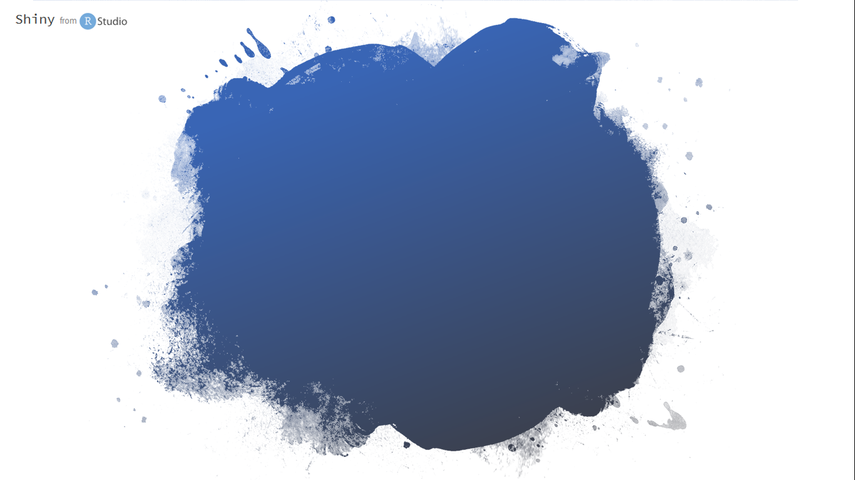
Programming is a skill best acquired by practice and example rather than from books.
-Alan Turing-

Slide 34

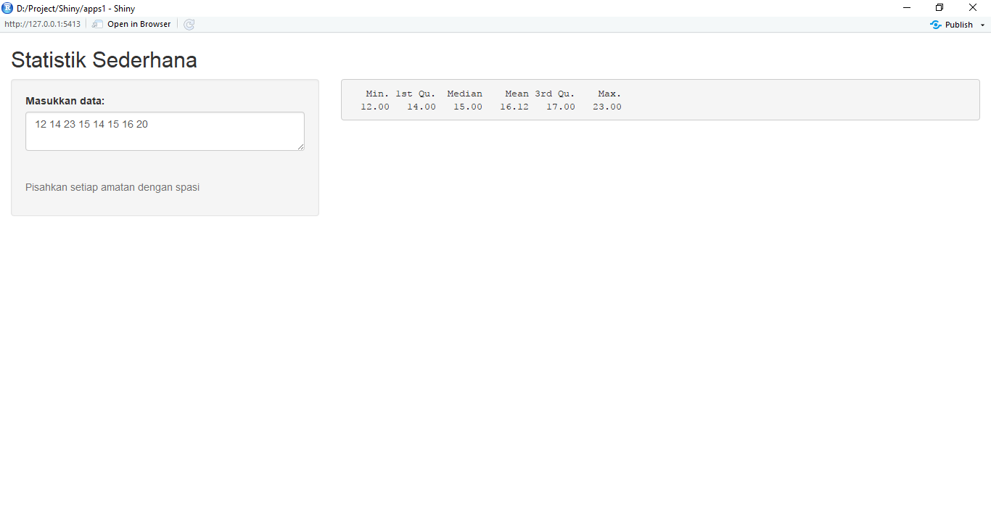
Example 1 - Simple Statistical Descriptive
Create an single file app (app.R) and multiple file to display statistical descriptive from the typed data.
You can use textInput() or textAreaInput() as input field.
Split data by space, convert list object as vector using unlist() and convert as numeric vector with as.numeric() function.
Last, compute simple statistics with summary() function.
The app’s full code is available on http://bit.ly/STCExp1

Slide 35
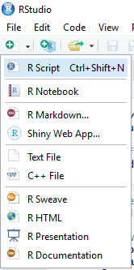
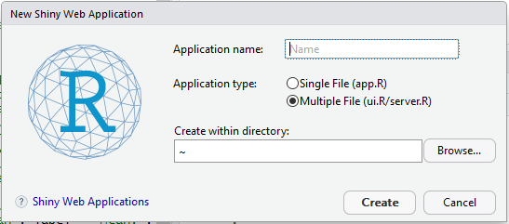
Using RStudio Menu
Create shiny apps template from RStudio
Provide Application name
Choose Single File (app.R) or
Multiple File (ui.R/server.R) for Application Type
Select folder for created shiny apps

Slide 36
Publish Shiny App
Deploy And Publish Shiny App

Slide 37
Deploy Shiny Apps
There are two ways to deploy the apps :
Locally | → | you can run the apps on your own local machine (local server) or local area network (no need internet access).
Web | → | deploy your apps to the web hosting. Shinyapps.io is free!

Slide 38
Deploy Your Apps To Web
If you want your Shiny app to be accessible over the web, so that users only need a web browser and internet access.
Shinyapps.io is a platform as a service (PaaS) for hosting Shiny web apps.
Before you get started with shinyapps.io, you will need the latest version of the rsconnect R package,
install.packages("rsconnect")
and Create a shinyapps.io account.

Slide 39
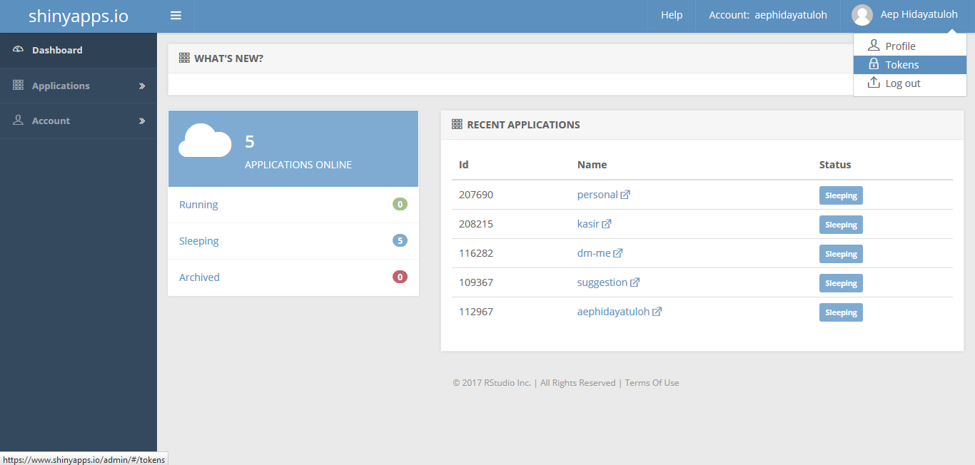
Create shinyapps.io Account
Go to https://www.shinyapps.io and create a new account by sign up or log in if you already have.

Slide 40
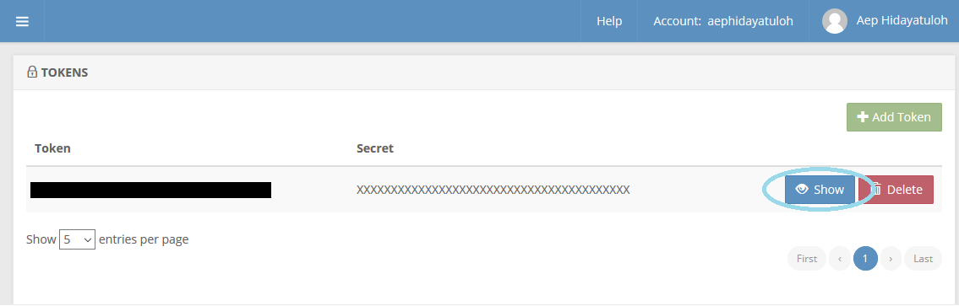
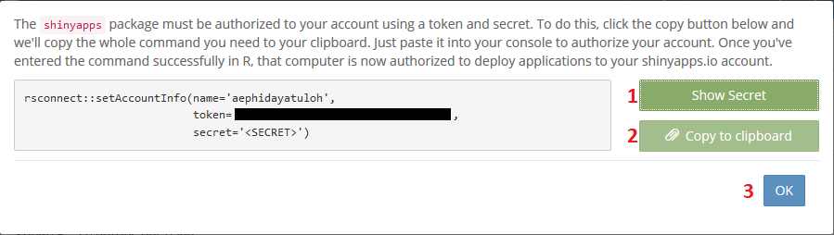
Generate Token
Generate token and copy

Slide 41

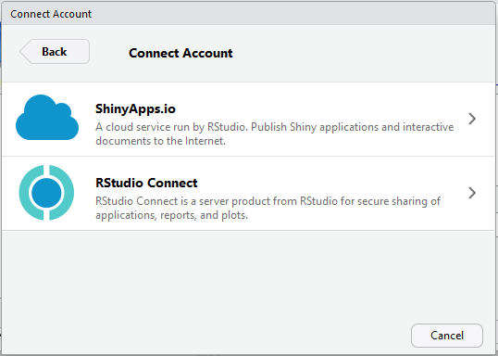
Publish Apps

Slide 42
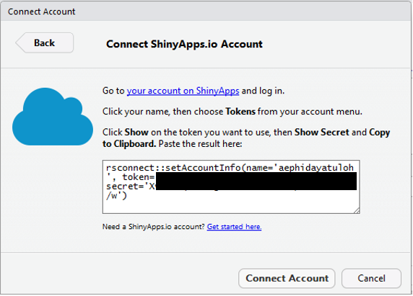
Setting Connection
Copy and Paste the copied token

Slide 43
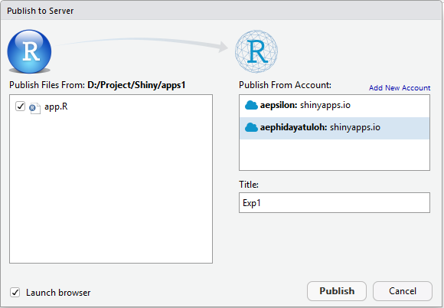
Apps Name
Open the created app: https://aephidayatuloh.shinyapps.io/Exp1

Slide 44
Summary
We can create interactive apps for data visualization, i.e. dashboard, spatial maps etc, or data entry form.
Shiny apps is very extensible – HTML, CSS, JavaScript and JQuery.
Create Shiny Apps with UI and Server
Publish Shiny Apps – local or web; free or paid.

Slide 45


